Slide 1


Slide 2



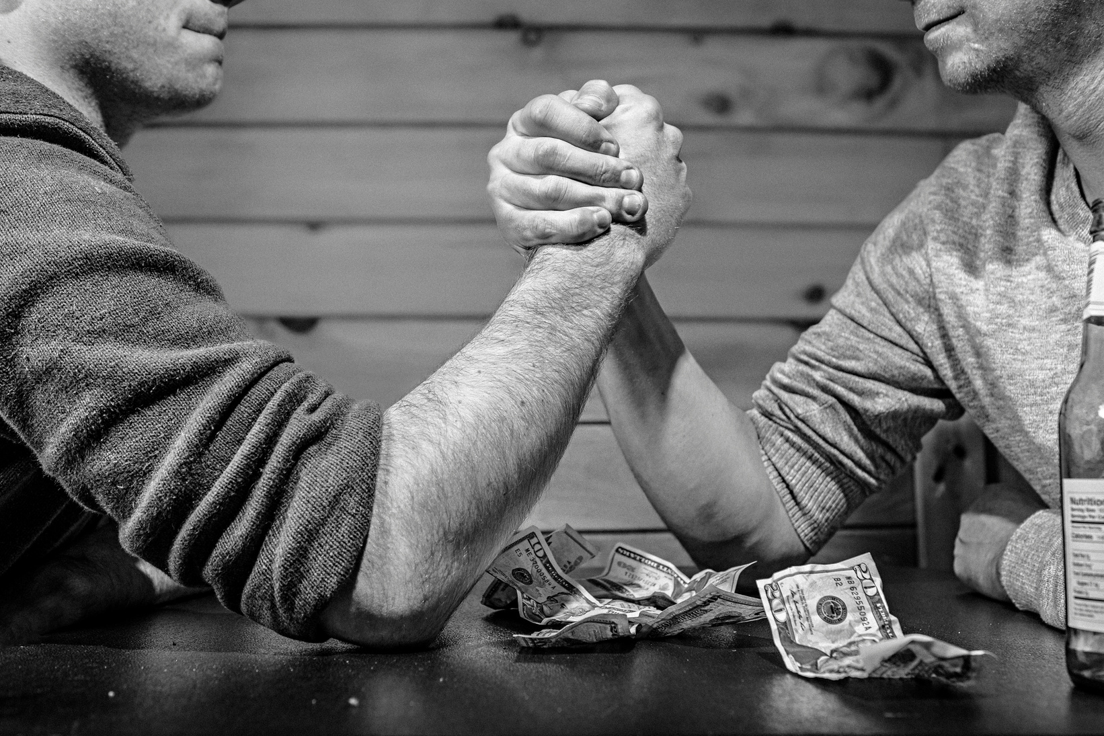
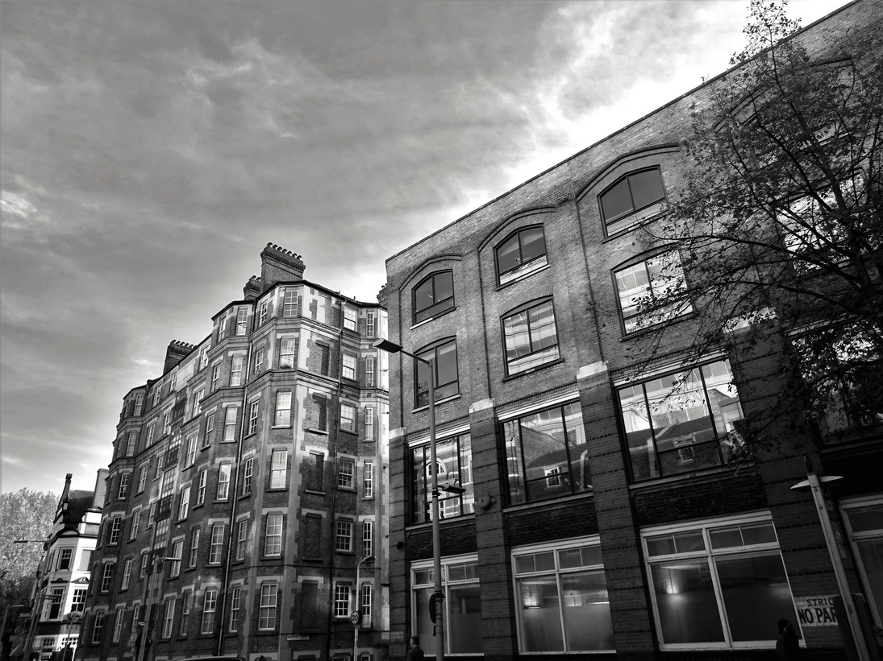
SOCIAL COMPARISON
Huong Noi

Slide 3
MEMBERS
No | NAME | STUDENT ID CODE | TASK
1 | Nguyễn Tấn Kiệt | QE170003 | Synthesize information
2 | Bùi Ngọc Bảo Trân | QE170086 | Design Slide
3 | Trần Thu Ngân | QE170115 | Prepare Script
4 | Vũ Ngọc Ánh | QE170052 | Look for information
5 | Nguyễn Hoàng Anh Tuấn | QE170044 | Look for information

Slide 4

OVERVIEW
  “Never compare yourself to others. It's really useless and makes you sick and tired."
  Every day, we cannot avoid the moments when we see other people "something more than us".
  Many recent psychological studies have shown that frequent use of social networks makes people more negative and strict with themselves.

Slide 5

DEFINITION
Social comparison theory was proposed by the sociologist Leon Festinger in 1954. To evaluate themselves, people compare abilities, opinions, values, attitudes, location, etc. position, property, appearance, ... with one or a group of other people.

Slide 6

CONSISTS OF
Upward social comparison
Downward social comparison

Slide 7
CONSISTS OF
The above comparison is the process by which you judge yourself against someone you consider superior to yourself in a certain aspect.
Upward social comparison

Slide 8
CONSISTS OF
In contrast to the upper comparison, the lower comparison is the process by which an individual evaluates himself to someone who is inferior to them in some way.
Downward social comparison

Slide 9

MAIN IDEA
  However, our group believes that we are very separate people with different qualities and dreams. In each stage of life, always find your "own sky" and live it to the fullest.
  Never compare yourself to others because you will have no control over your ambitions and we tend to indulge in the negative rather than the positive in the process of comparison.

Slide 10

CONTENT
1
2
EXPRESSION
REASON
3
4
CONSEQUENCE
SOLUTION

Slide 11
1
EXPRESSION

Slide 12

EXPRESSION
We can see the expression of comparison anytime, anywhere in life. Why? Because social comparison appears a lot, even very often in everyday life.

Slide 13




EXPRESSION
There are 4 main types of comparisons
Compare with others
Compare with social prejudice
In work
In life

Slide 14


COMPARE WITH OTHERS
Today, in the development of information technology and social networking platforms, perhaps just a few mouse clicks or a few swipes on the screen, it is not difficult to get news about social comparisons appear right at our fingertips.

Slide 15
COMPARE WITH OTHERS
A typical comparison in this section is called: "Another's son"

Slide 16

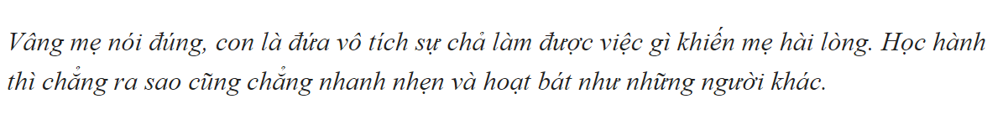
COMPARE WITH OTHERS

Slide 17
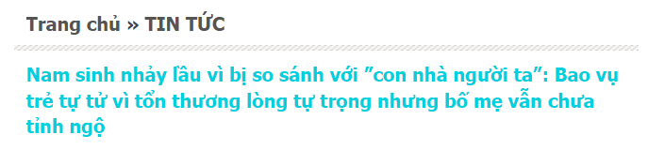
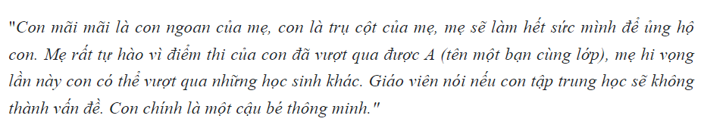
COMPARE WITH OTHERS

Slide 18
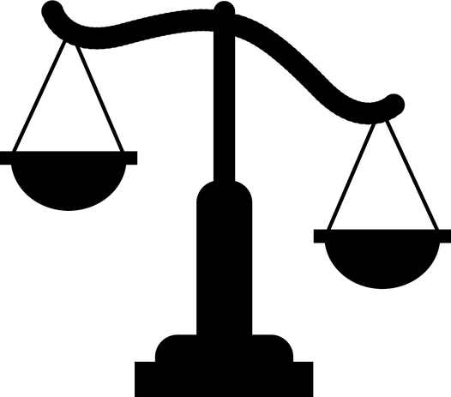
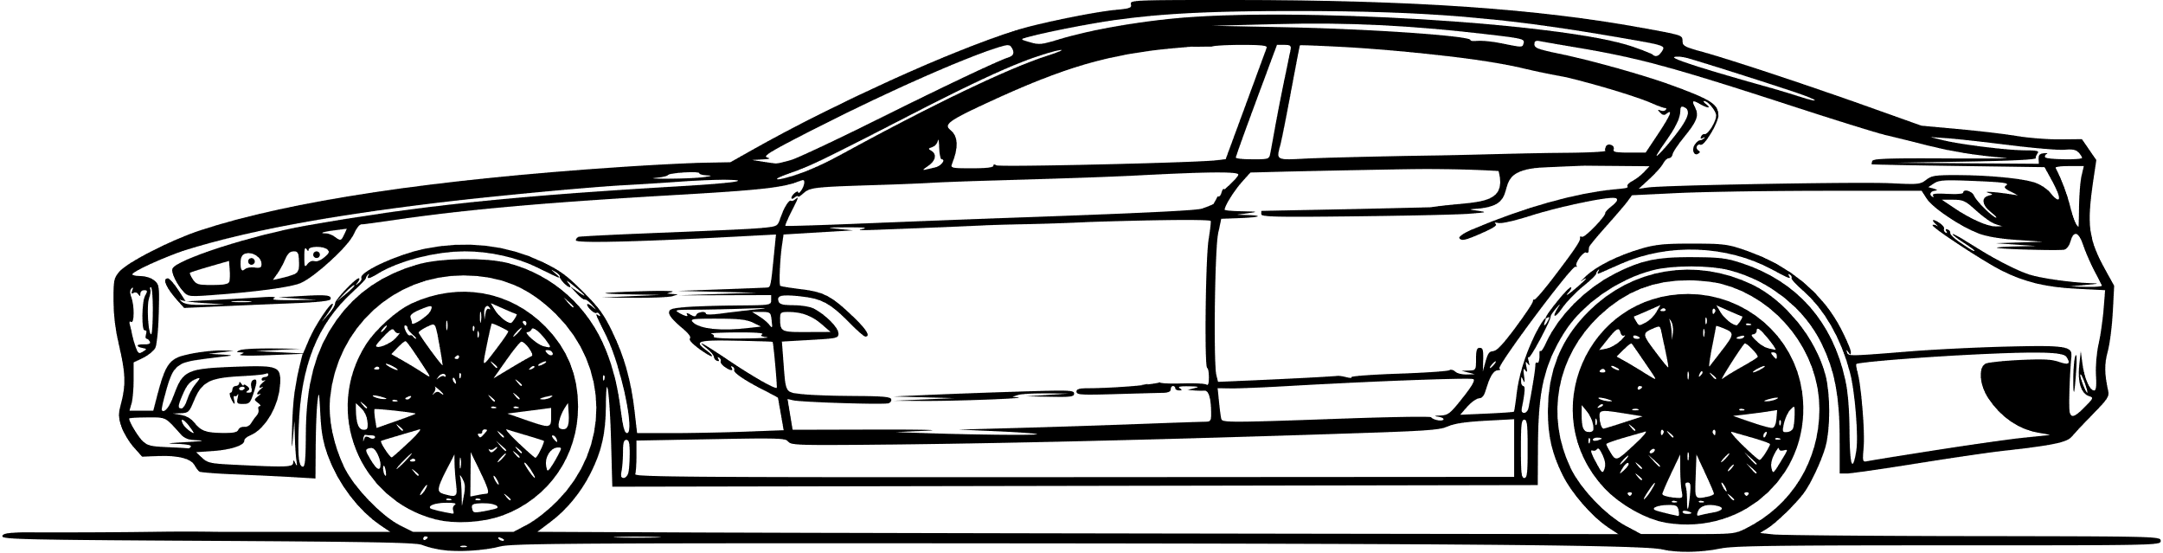
IN WORK
  You compare with a colleague, a classmate just because they drove a new car to school today, because today they can go to the board to solve a difficult exercise. It's a very small comparison that everyone seems to have experienced.
  You compare and feel unfair to a newcomer who enjoys many company benefits, …

Slide 19

IN LIFE
  You compare yourself to someone who has a more comfortable life, or even to someone who has a more difficult life.
  You feel jealous of someone who has discount codes on online shopping sites that you don't have. These are all manifestations of social comparison.

Slide 20

COMPARE WITH SOCIAL PREJUDICE
Another example that we often see less often is: comparing ourselves to social prejudices. We live in an eastern society, where prejudice is still very strongly placed, and it seems to be deeply rooted in each of us.

Slide 21

2
REASON

Slide 22

REASON
Subjective
Objective

Slide 23

SUBJECTIVE
  Because everyone wants to be equal to everyone in society, due to the jealous nature of each person.
  Never know enough, do not know how to appreciate what you have.
REASON

Slide 24

OBJECTIVE
  Being compared to others.
  Being provoked leads to comparisons.
REASON

Slide 25

3
CONSEQUENCE

Slide 26
CONSEQUENCE
IN PSYCHOLOGY
IN TERMS OF PERSONALITY
Make yourself more and more timid, afraid and lose confidence at work, reducing your ability to study and create in the future. From there, we tend to do things that are praised and admired by others rather than doing what we feel like and passionate about.
We will easily envy and hate our "models".
When you compare yourself to others, you have entered an unequal battle.

Slide 27

4
SOLUTION

Slide 28
SOLUTION
BE CONTENT WITH WHAT YOU HAVE
ALWAYS APPRECIATE AND BE GRATEFUL
ALWAYS BE FAIR TO YOURSELF
Remember: what you have is not necessarily everyone can have, so cherish and be grateful for your present happy life.
Before you try to compare yourself to anyone, find the most balanced point of view possible for this balance.
You should focus on what you already have instead of craving for what you lack.

Slide 29
SOLUTION
SEE YOUR STRENGTHS
ACCEPT THE FACT THAT NO ONE IS PERFECT IN THE WORLD
Comparing yourself to others is rooted in your low self-esteem, so building your confidence is crucial to getting those super negative thoughts out of your head.
No one in this world will be perfect, not even those that we always admire and wish to be like them.

Slide 30

People feel most confident and comfortable when they are exposed to their own personality.
You should think for yourself and set up a "skyframe" for yourself, so that when you live with it, you will also appreciate and be proud of yourself, even when it's difficult.

Slide 31

THANK YOU

